Slide 1
Design and Implement Cloud Data Platform Solutions

Slide 2
08 | Design and Implement Cloud Data Platform Solutions

Slide 3
Agenda
1
Microsoft Data Platform
5
Hybrid HA/DR Scenarios with SQL Server
2
Implement SQL Server on Azure VM
6
Design and Implement Security
3
Implement SQL Database
7
Monitor and Manage Implementations on Azure
4
SQL Database High Availability and Disaster Recovery
8
Design and Implement Database Solutions for SQL Server and SQL Database

Slide 4
In this module
Case Study – SQL Server Hybrid Scenario
Case Study – Lift and Shift

Slide 5

Real-world Case Study Workshop
SQL Server Hybrid Cloud

Slide 6
Step 1: Review the customer case study
Outcome
Analyze your customer’s needs
Timeframe
15 minutes

Slide 7
Customer situation: Fabrikam Publishing
Fabrikam Publishing is a media and publishing company in Seattle, Washington, with approximately 5,000 employees. It has a successful direct-to-consumer e-commerce site built with .NET and using SQL Server to store customer profile and order information.
Fabrikam has a single data center for both internal and customer-facing applications. Most servers are virtualized on VMware. Application servers primarily run Microsoft server software, including Active Directory (AD) Domain Services and a number of AD-integrated services, including Exchange 2013, as well as multi-tier, internal, AD-integrated Microsoft Internet Information Services (IIS)–based web applications with will support SQL Server 2016 as the database platform.

Slide 8
Customer situation: Fabrikam Publishing (cont.)
Fabrikam’s e-commerce site recently experienced a multi-day outage due to a lightning strike, which disabled both the primary and secondary cooling systems at the data center causing a 16-hour outage while the cooling systems were repaired.
“A disaster recovery site has been on our project proposals for the last four years, but it has always been shelved due to budget constraints,” says Michelle Jenkins, Chief Information Officer (CIO).
Fabrikam now has board approval for additional funds to build out a new disaster recovery (DR) site. To keep capital expenditures in check, Fabrikam would like to use the public cloud to host its DR site.

Slide 9
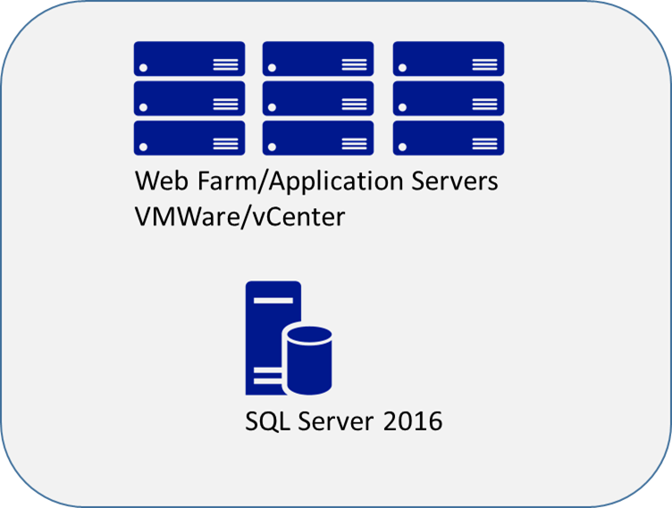
Disaster recovery strategy
Current situation
Classic backup/restore.
No offsite warm standby machines are available.
Backups are dumped to a file share, which is then backed up to tape and shipped offsite.
No automation, all steps are currently manual.
Disaster site relies on temporary hardware rented from a hosting facility.
Failover has never been tested due to cost and complexity.
Maintenance jobs are running too long due to large tables with no archive strategy.

Slide 10
Customer needs
Full, multi-site disaster recovery solution with minimal complexity, orchestrated failover, and near-zero data loss.
Highly available, fault-tolerant SQL Server service with cross-site disaster recovery.
The ability to seamlessly scale DR site infrastructure as the environment grows.
Data archiving to keep database sizes more manageable and reduce the amount of time needed for database maintenance.
Secure offsite backups in less than two hours.

Slide 11
Customer objections
Solution must support orchestrated failover so that failover does not require all hands on deck.
Solution must support the existing VMware infrastructure.
DR infrastructure must be easily scalable to support changes in the workload.
Both primary and DR sites must be highly available.
Archive solution must leave 12 months of data online to support normal production OLTP access.
Archive solution must not impact the current reports, which periodically pull historical data from the production system.
Backups need to be secured offsite in less than two hours.

Slide 12
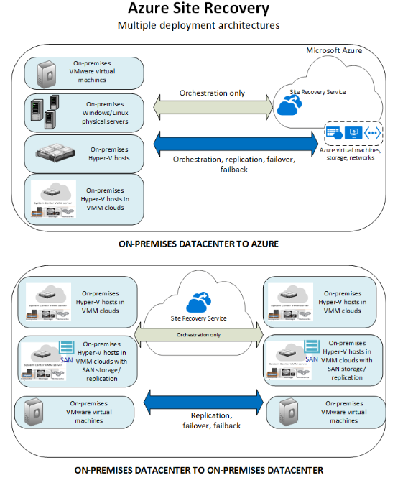
Common scenarios – Azure Site Recovery
Support for on-premises to on-premises, and on-premises to Azure failover
Automated protection and replication of on-premises, Hyper-V, and VMware machines
Orchestrated failover
Customizable recovery plans
Recovery plan testing

Slide 13
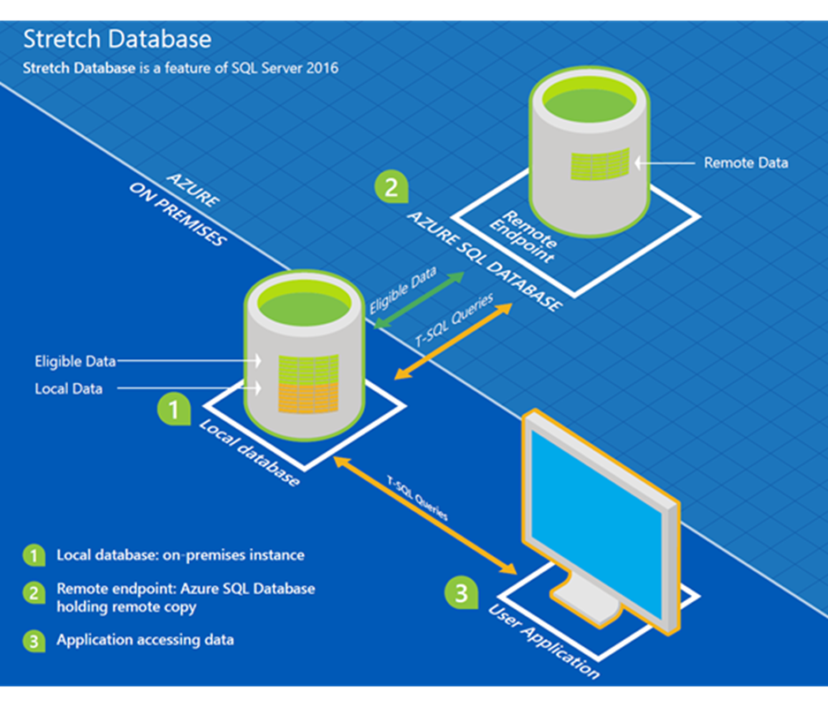
SQL Server Stretch Database
Ensures cost-effective availability of cold data
Requires no changes to queries or applications
Streamlines on-premises data maintenance
Keeps data secure during migration

Slide 14
SQL Server Backup to URL
Backups direct to private Azure Storage means that backups are offsite immediately.
Geo-redundant storage provides even further protection from regional disasters.
Near limitless storage for backups.
No maintenance costs for backup or storage hardware.
Backup files are available immediately and indefinitely.

Slide 15
Step 2: Call to action – design the solution
Outcome
Design a solution and prepare to present the solution to the target customer audience in a 15-minute chalk-talk format.
Timeframe
60 minutes
Business Needs (10 minutes) | Respond to questions outlined in your guide and list the answers on a flip chart.
Design (35 minutes) | Design a solution for as many of the stated requirements as time allows. Show the solution on a flip chart.
Prepare (15 minutes) | Identify any customer needs that are not addressed with the proposed solution. Identify the benefits of your solution. Determine how you will respond to the customer’s objections. Prepare for a 15-minute presentation to the customer.

Slide 16
Step 3: Call to action – present the solution
Outcome Present a solution to the target customer audience in a 15-minute chalk-talk format.
Timeframe
30 minutes
Directions
Each table team pairs with another table.
One table is the Microsoft team and the other table is the customer.
The Microsoft team presents its proposed solution to the customer.
The customer asks one of the objections from the list of objections.
The Microsoft team responds to the objection.
The customer team gives feedback to the Microsoft team.
Tables switch roles and repeat Steps 2 through 6.

Slide 17
Wrap-up
Outcomes
Identify the preferred solution for the case study.
Identify solutions designed by other teams.
Timeframe
15 minutes

Slide 18
Real-world Case Study Workshop
SQL Hybrid Cloud
Preferred Solution

Slide 19
Preferred target audience
Michelle Jenkins, Chief Information Officer
James Sherburn, Director, IT Operations
Robert Moore, Manager, Database Administration

Slide 20
Preferred solution overview
The solution for Fabrikam’s scenario involved several technologies, including:
Implementing Azure Site Recovery to replicate VMware virtual machines to Azure and orchestrate failover in the event of a disaster
Using SQL Server AlwaysOn Availability Groups to provide synchronous high availability on-premises
Using SQL Server AlwaysOn Availability Groups to provide asynchronous disaster recovery in Azure
Using SQL Server Stretch Database to archive historical data to Azure SQL Database
Implementing SQL Server Backup to URL to send backups to Azure Storage
Let’s review in more detail.

Slide 21
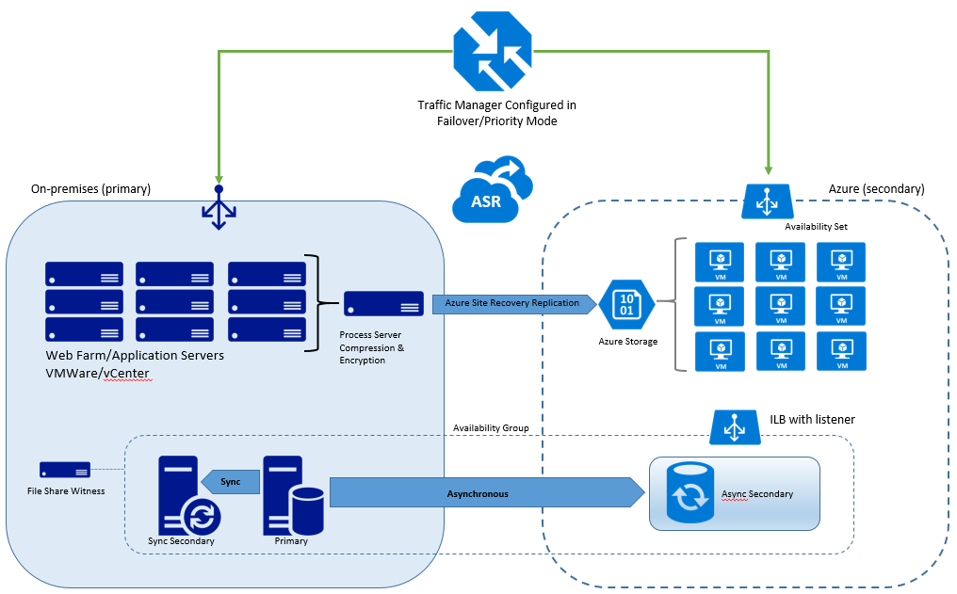
Plan for high availability and disaster recovery
Traffic Manager will be configured on two external endpoints (the existing on-premises site and a site that you will pre-configure in DNS for when ASR fails over). When Traffic Manager detects an outage on the primary on-premises site, it will failover DNS resolution to the pre-configured site in Azure.
Azure Site Recovery will be used to protect the web farm and orchestrate failover of the web farm and the SQL Server in the event of a disaster.
The disaster recovery virtual machines in Azure will remain offline until failover. Replicated data will be sent directly to the VHD files sitting in Azure Storage.

Slide 22
Plan for high availability and disaster recovery (cont.)
The SQL Server databases will be protected by SQL Server AlwaysOn Availability Groups.
For on-premises high availability, we will use Synchronous Availability Groups with automatic failover.
The disaster recovery SQL Server virtual machines in Azure will use asynchronous replicas of the availability group.
In addition to the process server on-premises, an Active Directory domain controller would also need to be deployed in Azure to support AlwaysOn.

Slide 23

Data archiving
Use SQL Server Stretch Database to migrate historical data transparently and securely to Azure SQL Database.
Ask the following questions before implementing a data archiving solution:
What is the retention period of the data?
Will the archived data need to be modified or is it immutable?
How many large tables are there in the database?
How many tables in total?
Use the Stretch Database Advisor to identify tables for Stretch Database and flag any blocking issues.
Stretch Database will not require any changes to the existing reporting system; however, queries that touch historical data may run more slowly.
Maintenance performance should be improved. Maintenance will act on only the local data.

Slide 24
Offsite backup
SQL Server Backup to URL provides the most straightforward replacement of the existing backup solution.
SQL Server Backup to URL uses an Azure Storage in your subscription to perform an offsite backup.
Azure Storage access control prevents unauthorized access by requiring a key to access the storage account.
Using the WITH ENCRYPTION option in the backup command further secures the backup from unauthorized backup.
Geo-redundancy in Azure Storage asynchronously copies the backup files to a second region.

Slide 25
Customer objections
Objection
Solution must support orchestrated failover so that failover does not require all hands on deck.
Potential answer
Azure Site Recovery orchestrates replication of your on-premises and virtual machines to a secondary on-premises data center or to Azure. Site recovery handles the VM replication and integrates with SQL Server Availability Groups. Failover can be kicked off with a simple click.

Slide 26
Customer objections (cont.)
Objection
Solution must support the existing VMware infrastructure.
Potential answer
Azure Site Recovery supports the replication of on-premises servers, Hyper-V virtual machines, and VMware virtual machines.

Slide 27
Customer objections (cont.)
Objection
Disaster recovery infrastructure must be easily scalable to support changes in the workload.
Potential answer
As workloads change, Azure virtual machines may be scaled up or down as necessary to provide the appropriate amount of resources. This can be done by modifying the virtual machine size.

Slide 28
Customer objections (cont.)
Objection
The disaster recovery sites must be highly available after a failover.
Potential answer
By placing Azure virtual machines into an Availability Set, you can keep your virtual machines available during downtime, such as during maintenance or unplanned outages. It is a best practice to use availability sets and load-balancing endpoints to help ensure that your application is always available and running efficiently.
SQL Server virtual machines will rely on a combination of Availability Sets and SQL Server Availability Groups to maintain uptime and synchronization. The SQL Servers will belong to a separate Availability Set from the web servers and will also use an internal load balancer.

Slide 29
Customer objections (cont.)
Objection
Archive solution must not impact the current reports, which periodically pull historical data from the production system.
Potential Answer
SQL Server Stretch Database does not require any changes to existing queries or applications, the location of the data is completely transparent to the application. The entire table is always online and can be queried. You will set the policy that determines where the data is stored either on the local server or in Azure.

Slide 30
Customer objections (cont.)
Objection
Backups need to be secured offsite in less than two hours after completion.
Potential Answer
SQL Server Backup to URL backs up databases directly to Azure Storage. As soon as the backup is complete, it is offsite and protected. Furthermore, if using geo-redundant storage, your database backups will be asynchronously replicated to a secondary region hundreds of miles away.

Slide 31
Customer quote
“By using Azure, we have the confidence that we can keep our business running in the event of a disaster, with minimal overhead and near-zero data loss”
—Michelle Jenkins, Chief Information Officer, Fabrikam Publishing

Slide 32
Real-world Case Study Workshop
Lift and Shift

Slide 33
Step 1: Review the customer case study
Outcome
Analyze your customer’s needs
Timeframe
15 minutes

Slide 34
Customer situation: Lucerne Publishing
Lucerne Publishing is one of the largest English-language publishers in the world. With nearly 200 years of history, Lucerne has published some of the world’s foremost authors, including winners of the Nobel Prize, Pulitzer Prize, National Book Award, Newbery Medal, and Caldecott Medal. Lucerne is consistently at the forefront of innovation, using digital technology to create unique reading and viewing experiences and expand the reach of its authors and documentary producers.
Lucerne is headquartered in New York City and has publishing groups in the United States, United Kingdom, Canada, Australia, New Zealand, and India.

Slide 35
Customer situation: Lucerne Publishing (cont.)
Lucerne is starting a three-year project to move the majority of its data center footprint to the cloud. “We are convinced that cloud implementations will give us cost savings and, more importantly, deliver operational flexibility,” says Greg Vernon, Head of Infrastructure and Enterprise Operations.
Lucerne has already enabled a successful implementation of Office 365 where it used Microsoft Azure Active Directory (AD) Connect to synchronize its on-premises identities to the cloud.
Lucerne wants to pilot a relatively high-impact workload directly in Microsoft Azure. The workload is a third-party procurement system that is hosted on-premises today and Lucerne would like to migrate to Azure with a minimal amount of changes.

Slide 36
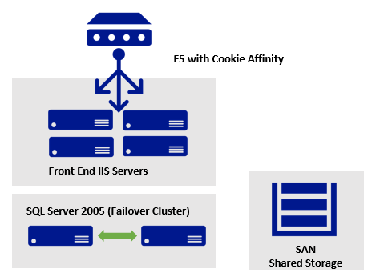
Procurement system
Current situation
Third-party app deployed on four Microsoft Internet Information Services (IIS) physical servers
ASP.NET with .NET 3.5
App deployed via a wizard to install assemblies into the global assembly cache (GAC)
F5 with Cookie Affinity for session state support
Back-end SQL 2005/Failover Cluster (app is compatible with SQL Server 2014)
App uses distributed queries, heavy use of TempDB, and SSRS and has a maximum database size of just 200 GB
SQL hardware: quad-core 2.5GHz Intel Xeon processors and 16 GB of memory on each server

Slide 37
Customer needs
Identify the infrastructure requirements and plan for establishing a connection with Azure ExpressRoute that will support the customer’s migrated infrastructure and connectivity to Office 365
Isolated privileges for managing infrastructure in the cloud
Migration of the web tier to Azure with minimal changes to the application itself
Migration plan for the database tier
Understanding how offsite backup will work after migration

Slide 38
Customer objections
“We are confused by the terminology ‘classic’ and ‘resource manager.’ Does the resource manager deployment model support the services for our project?”
“The procurement application should only be accessible from people at Lucerne’s offices. Putting it in the cloud seems like a security problem.”
“We already have licenses for SQL Server. We do not want to pay for them again.”
“Our operations team is new to the cloud and currently uses existing technologies like SCOM. We are concerned about the time it takes to learn new technologies to monitor and maintain an existing workload.”
“We have heard that to grant someone access to an Azure subscription means they can manage all resources. This would be a blocker to us.”

Slide 39
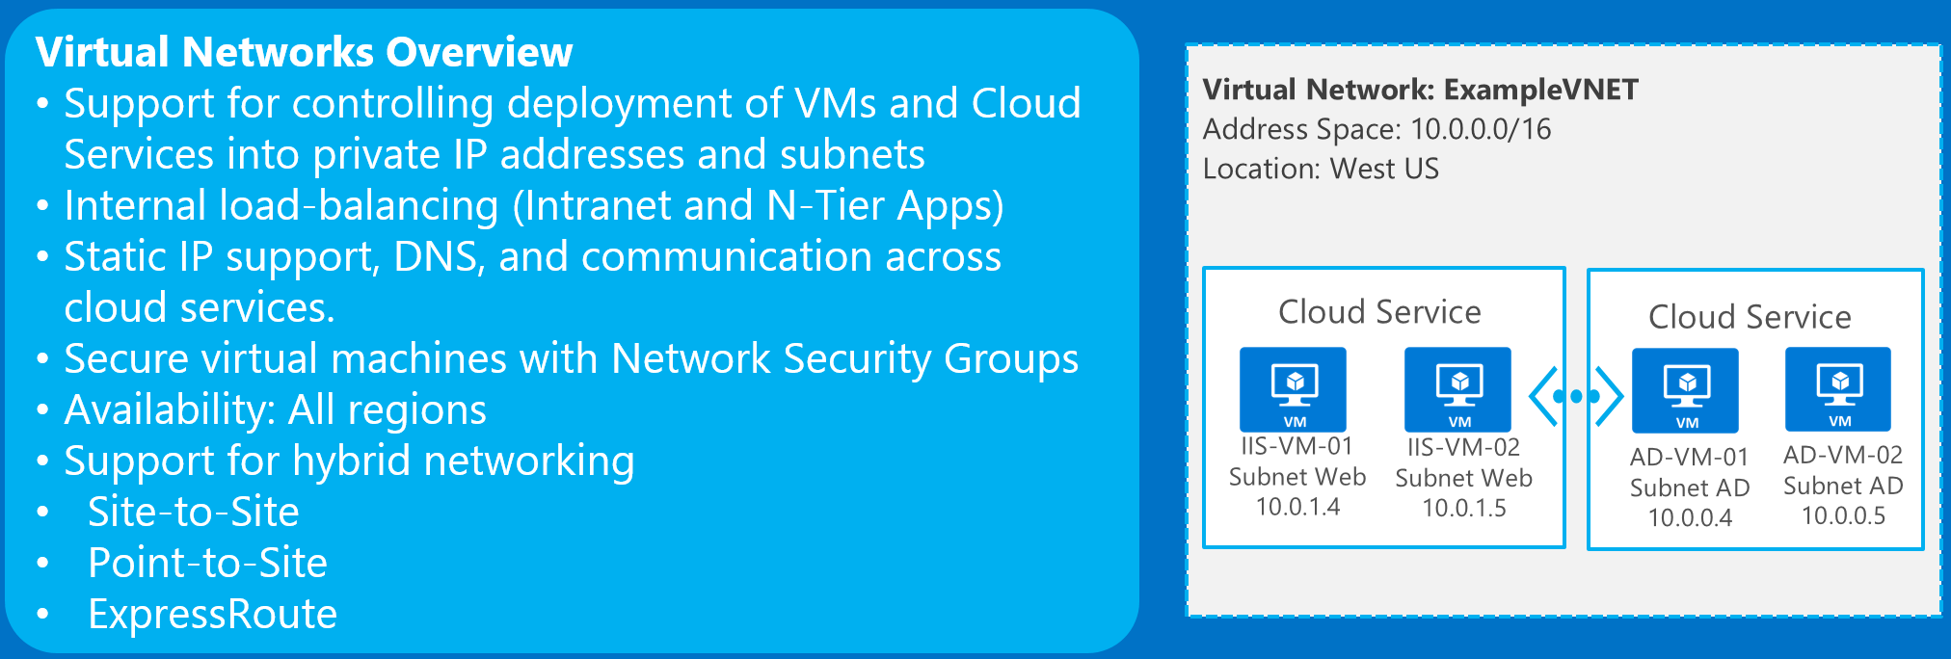
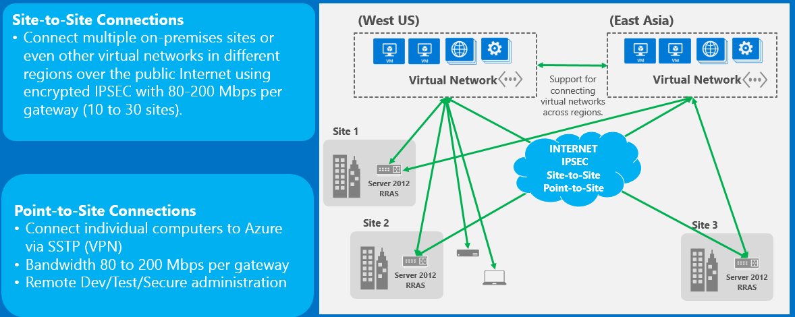
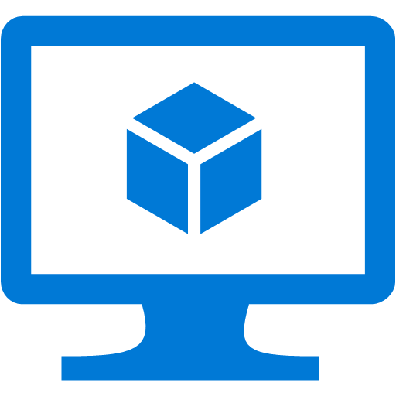
Common scenarios – infrastructure as a service
Virtual Machines overview
Supports Windows or Linux workloads
Sizes from: 1 core 778 MB to 32 and 448 GB
Full control
Direct connectivity to virtual networks
Familiar tools
Support for automated management and deployment using templates or scripts

Slide 40
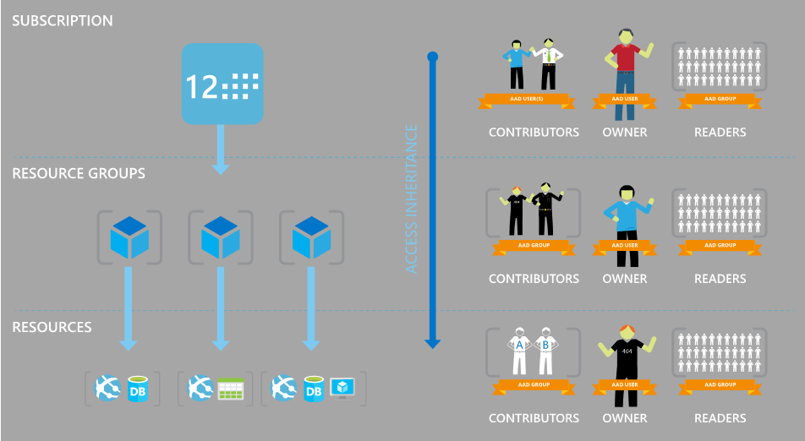
Role-based access control (RBAC)

Slide 41
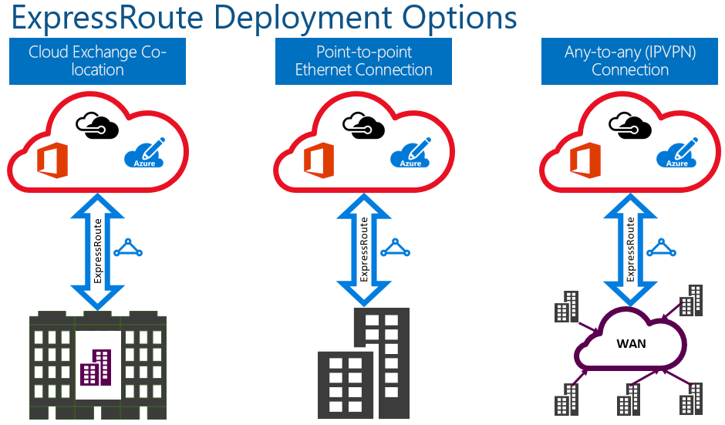
ExpressRoute

Slide 42
Step 2: Call to action – design the solution
Outcome
Design a solution and prepare to present the solution to the target customer audience in a 15-minute chalk-talk format.
Timeframe
60 minutes
Business Needs (10 minutes) | Respond to questions outlined in your guide and list the answers on a flip chart.
Design (35 minutes) | Design a solution for as many of the stated requirements as time allows. Show the solution on a flip chart.
Prepare (15 minutes) | Identify any customer needs that are not addressed with the proposed solution. Identify the benefits of your solution. Determine how you will respond to the customer’s objections. Prepare for a 15-minute presentation to the customer.

Slide 43
Step 3: Call to action – present the solution
Outcome Present a solution to the target customer audience in a 15-minute chalk-talk format.
Timeframe
30 minutes
Directions
Each table team pairs with another table.
One table is the Microsoft team and the other table is the customer.
The Microsoft team presents its proposed solution to the customer.
The customer asks one of the objections from the list of objections.
The Microsoft team responds to the objection.
The customer team gives feedback to the Microsoft team.
Tables switch roles and repeat Steps 2 through 6.

Slide 44
Wrap-up
Outcomes
Identify the preferred solution for the case study.
Identify solutions designed by other teams.
Timeframe
15 minutes

Slide 45
Real-world Case Study Workshop
Lift and Shift
Preferred solution

Slide 46
Preferred target audience
Greg Vernon, Head of Infrastructure and Operations
Jesse Adams, Infrastructure Lead
Identity and Security Leads

Slide 47
Preferred solution overview
The solution for Lucerne’s scenario involved several technologies, including:
Using RBAC to control access to the networking and procurement resources separately
Using tools such as Disk2VHD and the Azure PowerShell cmdlets to migrate the web app disks to Azure. In the future, when resource manager + VMware is supported, this could use Azure Site Recovery
Upgrading the database to SQL Server 2014 with AlwaysOn Availability Groups
Deploying the web and database tier on Azure Virtual Machines.
From a networking perspective. they used Azure ExpressRoute configured with public, private, and Microsoft peering for connectivity to Azure AD, Office 365, and Azure Virtual Networks.
The Azure Application Gateway was chosen for load-balancing to address cookie session management requirements, and network security groups to lock down access to only the on-premises users.
Let’s review in more detail.

Slide 48
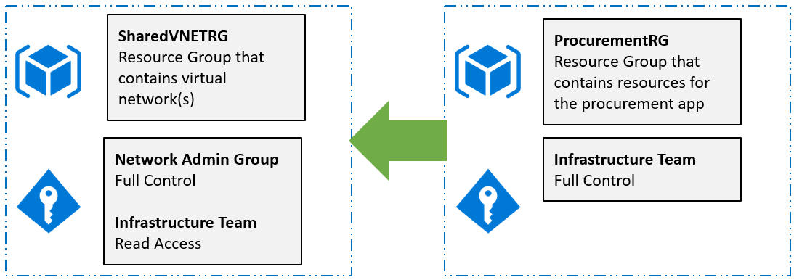
Design for limiting access to resources
Lucerne will need to change the Azure subscription default directory to point to the existing Office 365 AD tenant. This will require Global Admin rights on the Office 365 tenant.
When deploying resources, they should plan to deploy the virtual network into its own resource group. This will allow them to segment out resources and assign management rights to just the team that requires them.
The procurement resources should go in a separate resource group as they all share the same life cycle and should be managed by the same team.

Slide 49
Network architecture
Establish ExpressRoute connection using public, private, and Microsoft peering.
Enable the Premium option for ExpressRoute – this enables connectivity to all regions throughout the Microsoft backbone.
A simple Virtual Network design given the address space of 10.2.1.0/24 could have the following subnets
10.0.1.0/28 Procurement
10.0.1.16/28 Database
10.0.1.32/28 Gateway (ExpressRoute gateways require a /28 subnet)
A network security group should be created to allow in-bound and out-bound traffic from the on-premises 172.16.0.0/16 network and between the Procurement and Database subnets in Azure to minimize the attack surface.
Configure the Virtual Network to reference the existing AD DNS Infrastructure to enable users to successfully authenticate. Deploying domain controllers in the same virtual network would be advised once the deployment moves out of the pilot phase.

Slide 50
ExpressRoute integration – routing requirements
Private peering
You must reserve one /29 subnet or two /30 subnets for routing interfaces.
The subnets used for routing can be either private IP addresses or public IP addresses.
The subnets must not conflict with the range reserved by the customer for use in the Microsoft cloud.
If one /29 subnet is used, it will be split into two /30 subnets.
The first /30 subnet will be used for the primary link and the second /30 subnet will be used for the secondary link.
For each of the /30 subnets, you must use the first IP address of the /30 subnet on your router. Microsoft will use the second IP address of the /30 subnet to set up a BGP session.
You must set up both BGP sessions for your availability SLA to be valid.
Public and Microsoft peering
You must use public IP addresses that you own for setting up the BGP sessions. Microsoft must be able to verify the ownership of the IP addresses through Routing Internet Registries and Internet Routing Registries.
You must use a unique /29 subnet or two /30 subnets to set up the BGP peering for each peering per ExpressRoute circuit (if you have more than one).
If one /29 subnet is used, it will be split into two /30 subnets.
The first /30 subnet will be used for the primary link and the second /30 subnet will be used for the secondary link.
For each of the /30 subnets, you must use the first IP address of the /30 subnet on your router. Microsoft will use the second IP address of the /30 subnet to setup a BGP session.
You must set up both BGP sessions for your available SLA to be valid.
Make sure that your IP address and AS number are registered to you in one of the following registries: ARIN, APNIC, AFRINIC, LACNIC, RIPE NCC, RADB, ALTDB.

Slide 51
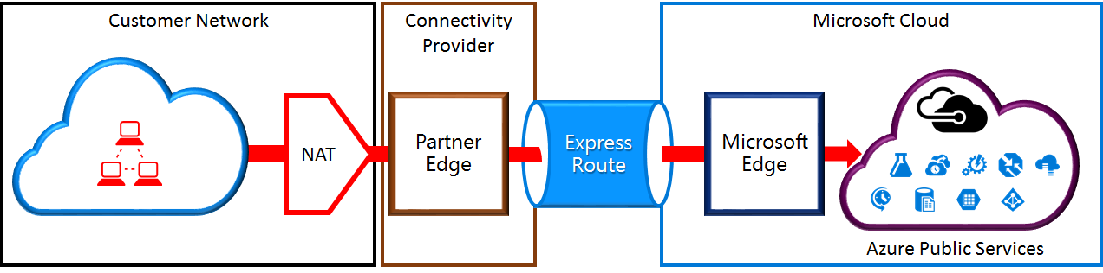
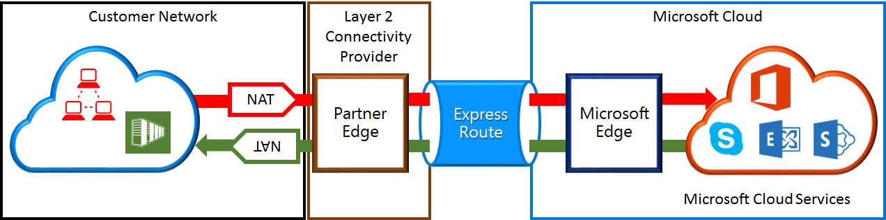
ExpressRoute integration – NAT requirements
The Azure public peering path enables you to connect to all services hosted in Azure over their public IP addresses. These include all services listed in the ExpessRoute FAQ and any services hosted by ISVs on Microsoft Azure. Connectivity to Microsoft Azure services on public peering is always initiated from your network into the Microsoft network. Traffic destined to Microsoft Azure on public peering must be SNATed to valid public IPv4 addresses before they enter the Microsoft network.
The Microsoft peering path lets you connect to Microsoft cloud services that are not supported through the Azure public peering path. The list of services includes Office 365 services, such as Exchange Online, SharePoint Online, Skype for Business, and CRM Online. Microsoft supports bi-directional connectivity via Microsoft peering. Traffic destined to Microsoft cloud services must be SNATed to valid public IPv4 addresses before they enter the Microsoft network.

Slide 52
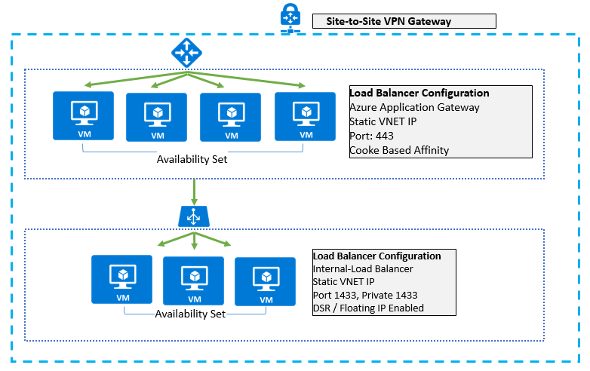
Procurement migration
Migrate to Virtual Machines for web
Configure with availability sets on each tier.
App has dependency on install wizard that installs to the global assembly cache (GAC)
Migrate to VMs for SQL Server 2014 with Always On
DS3 instance size closest match
Backup SQL straight to storage
Load Balancer Configuration
Azure App Gateway with ILB and cookie-based affinity
ILB for SQL with Direct Server Return for Always On

Slide 53
Migration steps
Run Disk2VHD on source web servers to generate VHDs from physical servers.
Create a storage account, virtual network, and establish site-to-site connectivity.
Update the virtual network to reference the domain controllers on-premises in DNS.
Use the Add-AzureRmVHD cmdlet to upload disks to a storage account.
Use PowerShell or a template to create the VMs for the web tier from disks into an availability set.
Create the Azure Application Gateway associated with the Procurement subnet.
Configure the front-end IP configuration with a static IP from the procurement subnet.
Configure the back-end server pool of IPs to reference the procurement web servers.
Set cookie-based affinity on the back-end HTTP server settings list.
Update DNS to map the hostname intranet to the static IP of the load balancer.
Create VMs for the database servers into their own availability set.
Install SQL Server on to the VMs using their existing SQL licenses.
Back up the SQL databases from on-premises and restore to the Azure VMs.
Update connection strings on the web apps.

Slide 54
Migration steps (ASR Method)
Use Azure Site Recovery to facilitate the migration. ASR does not currently support VMware to Azure resource manager failover or migrations (yet). When this support is available, it will be an alternative option.

Slide 55
Migration steps (ASR Method) (cont.)
Create the Azure Application Gateway associated with the Procurement subnet.
Configure the front-end IP configuration with a static IP from the procurement subnet.
Configure the back-end server pool of IPs to reference the procurement web servers.
Set cookie-based affinity on the back-end HTTP server settings list.
Update DNS to map the hostname intranet to the static IP of the load balancer.
Create Availability Sets for each tier of the application and assign the VMs appropriately.
Run a Test Failover to ensure that the VMs function properly.
Run a Planned Failover when ready to do the migration.
Reconfigure the SQL Server AlwaysOn Group to point to the new File Share Witness VM.
After the service has been verified to be up and functional, remove the machines from the protection group.

Slide 56
Customer objections
Objection
We are confused by the terminology ‘Classic’ and ‘Resource Manager.’ Does the resource manager deployment model support the services for our project?
Potential answer
Lucerne has the option to use either deployment model. Microsoft recommends that all new implementations use the Resource Manager moving forward. For a large-scale VM migration plan, Azure Site Recovery would be an ideal solution. The complexity would come in with respect to using Azure Site Recovery Manager as the migration method given that ASR has just recently started to support ARM and currently only supports Hyper-V. (Find more information here: https://azure.microsoft.com/en-us/documentation/articles/site-recovery-deploy-with-powershell-resource-manager/.)

Slide 57
Customer objections
Objection
The procurement application should only be accessible from people at Lucerne’s offices. Putting it in the cloud seems like a security problem
Potential answer
Using Azure networking capabilities like site-to-site VPN connectivity allows Lucerne to deploy the workload in the cloud and users to access it over a secure encrypted tunnel with IPsec. In the future, if Lucerne deployed ExpressRoute, this connection would be dedicated and private just to its organization and not traverse the Internet at all.
Network security groups can also be used to further limit what machines can communicate with the deployment. For instance, a network security group could be used only to allow the on-premises network and restrict other address spaces in the virtual network itself.

Slide 58
Customer objections
Objection
We already have licenses for SQL Server. We do not want to pay for them again.
Potential answer
Creating a virtual machine using the SQL Server premium image will charge Lucerne for the license. However, starting with a standard Windows Server image and installing SQL Server using Lucerne’s own key will mitigate this issue. Lucerne can also create its own custom SQL Server image for future deployments.

Slide 59
Customer objections
Objection
Our operations team is new to the cloud and currently uses existing technologies like SCOM. We are concerned about the time it takes to learn new technologies to monitor and maintain an existing workload.
Potential answer
Virtual machines in Azure are not that different from virtual machines in Hyper-V. With hybrid connectivity, their existing management solution SCOM could be used to manage the cloud-based deployment in the same way as they are today.

Slide 60
Customer objections
Objection
We have heard that to grant someone access to an Azure subscription they can manage all resources. This would be a blocker to us.
Potential answer
Although this is true when using the Azure Classic Portal, if you use the new Azure Portal you can assign fine-grained access permissions using RBAC. Rights are assigned to resource groups and resources allowing them to see only what they can manage when logging into the portal. (Note: this is only available to be used on Azure resources if they are not “classic.”)

Slide 61
Customer quote
“By using Azure, we can focus on our primary business, which is publishing, rather than on building and managing data centers, which can often be complicated, time-consuming, and expensive.”
—Greg Vernon, Head of Infrastructure and Enterprise Operations, Lucerne Publishing

